Slide 1


21 DAYS OF
MACHINE LEARNING
9/21
---Code Warriors---

Slide 2

What is Ensemble Learning
Ensemble learning, in general, is a model that makes predictions based on a number of different models. By combining individual models, the ensemble model tends to be more flexible🤸‍♀️ (less bias) and less data-sensitive (less variance).
Bagging
Boosting
Training a bunch of individual models in a parallel way. Each model is trained by a random subset of the data
Training a bunch of individual models in a sequential way. Each individual model learns from mistakes made by the previous model.
---Code Warriors---

Slide 3
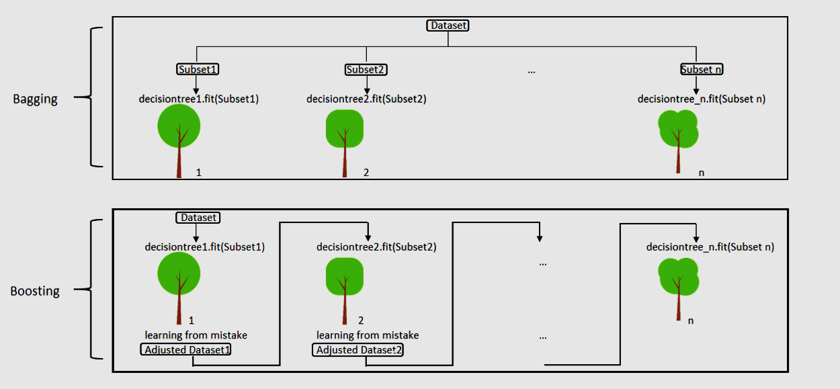
---Code Warriors---

Slide 4
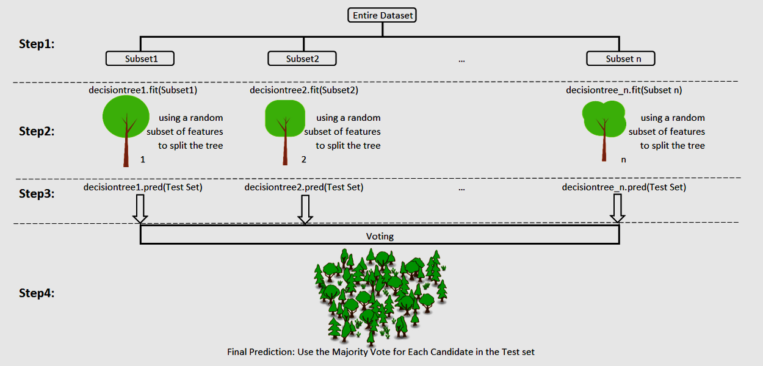
What is Random Forest Regression
It can be referred to as a ‘Forest’ of trees and hence the name “Random Forest”. The term ‘Random’ is due to the fact that this algorithm is a forest of ‘Randomly created Decision Trees’.
---Code Warriors---

Slide 5
Random Forest Model
1
from sklearn.ensemble import RandomForestRegressor
2
regressor = RandomForestRegressor(n_estimators = 10, random_state = 0)
3
regressor.fit(X_train.reshape(-1,1), y_train.reshape(-1,1))
4
y_pred = regressor.predict(X_test.reshape(-1,1))
---Code Warriors---

Slide 6
N_estimators
2
regressor = RandomForestRegressor(n_estimators = 10, random_state = 0)
N estimators represents the number of trees in the forest. Usually the higher the number of trees the better to learn the data. However, adding a lot of trees can slow down the training process considerably, therefore we do a parameter search to find the sweet spot.
---Code Warriors---

Slide 7
Random Forest Regression
Advantages
Dis-Advantages
Random Forest can be used to solve both classification as well as regression problems.
Random Forest works well with both categorical and continuous variables.
Random Forest can automatically handle missing values.
Random Forest is usually robust to outliers and can handle them automatically.
Complexity: Random Forest creates a lot of trees (unlike only one tree in case of decision tree) and combines their outputs. By default, it creates 100 trees in Python sklearn library. To do so, this algorithm requires much more computational power and resources. On the other hand decision tree is simple and does not require so much computational resources.
Longer Training Period: Random Forest require much more time to train as compared to decision trees as it generates a lot of trees (instead of one tree in case of decision tree) and makes decision on the majority of votes.
---Code Warriors---

